Slide 1
A research using Object Detection with a microscopic viewpoint to identify human activities for visually impaired people
Muntasir Ahmed Ador - 20101259
Nishat Zerin - 23341114
Sameer Sadman Chowdhury - 23341118
Rushayed Ali Faiaz - 21301717
RA: Adib Muhammad Amit
ST: Mehnaz Ara Fazal

Slide 2
Introduction/Motivation:
A research using Object-Detection with a microscopic viewpoint to identify human activities for visually impaired people

Slide 3
Dataset(COCO):
The COCO (Common Objects in Context) dataset is a large-scale image recognition dataset for object detection, segmentation, and captioning tasks. It contains over 330,000 images, each annotated with 80 object categories and 5 captions describing the scene. The COCO dataset is widely used in computer vision research and has been used to train and evaluate many state-of-the-art object detection and segmentation models.

Slide 4
Methodology:
Implemented:
Faster r-cnn
Opencv
Retinanet
Proposed:
4. HOG(Histogram of oriented gradients)
5. Mask r-cnn

Slide 5

Why me ?

Slide 6
Opencv:
Description:
OpenCV is the huge open-source library for computer vision, machine learning, and image processing and now it plays a major role in real-time operation which is very important in today's systems. By using it, one can process images and videos to identify objects, faces, or even the handwriting of a human.

Slide 7
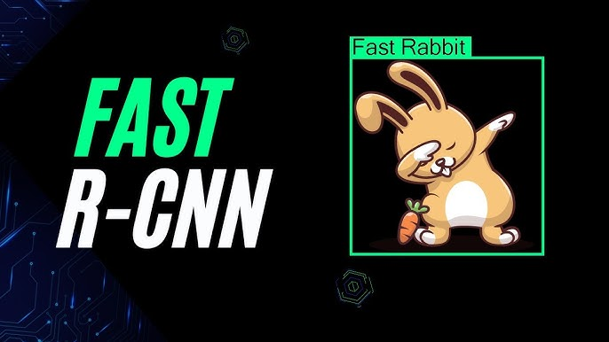
Why we used it ?

Slide 8
Description:
Faster R-CNN model is developed by a group of researchers at Microsoft. Faster R-CNN is a deep convolutional network used for object detection, that appears to the user as a single, end-to-end, unified network. The network can accurately and quickly predict the locations of different objects. In order to truly understand Faster R-CNN, we must also do a quick overview of the networks that it evolved from, namely R-CNN and Fast R-CNN.

Slide 9
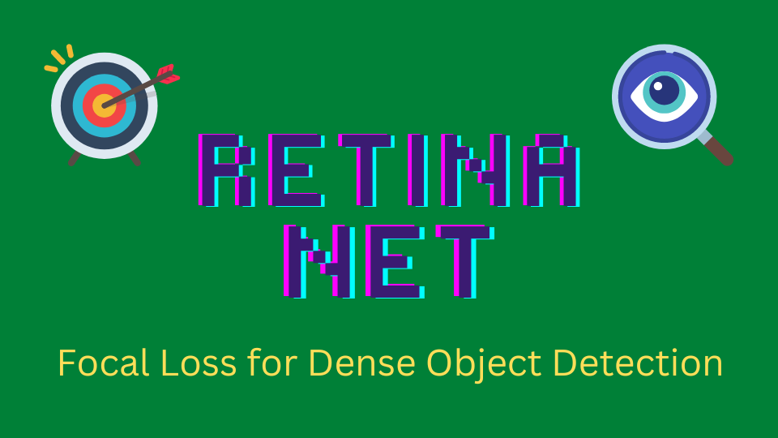

Slide 10
Description:
RetinaNet is a one-stage object detection model that utilizes a focal loss function to address class imbalance during training. Focal loss applies a modulating term to the cross entropy loss in order to focus learning on hard negative examples. RetinaNet is a single, unified network composed of a backbone network and two task-specific subnetworks. The backbone is responsible for computing a convolutional feature map over an entire input image and is an off-the-self convolutional network. The first subnet performs convolutional object classification on the backbone's output; the second subnet performs convolutional bounding box regression. The two subnetworks feature a simple design that the authors propose specifically for one-stage, dense detection.

Slide 11
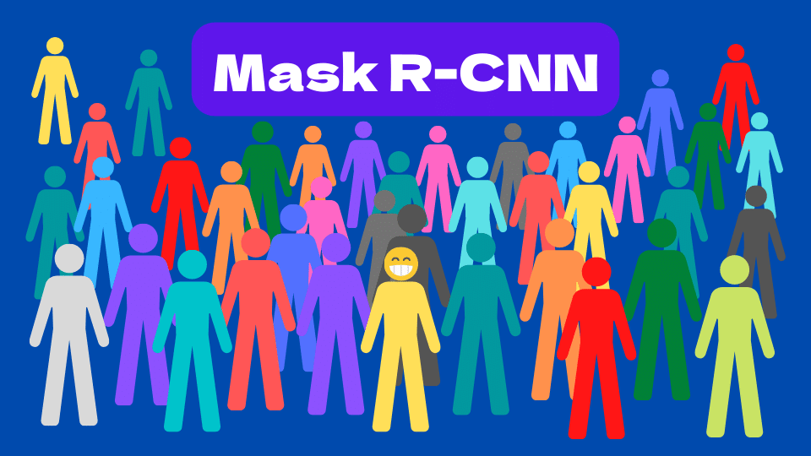
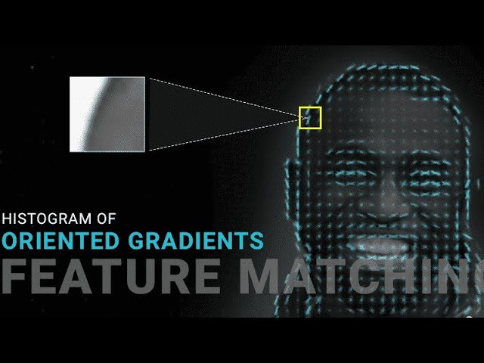
A little bit about the proposed models.

Slide 12
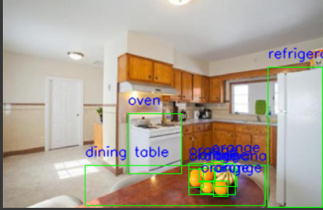
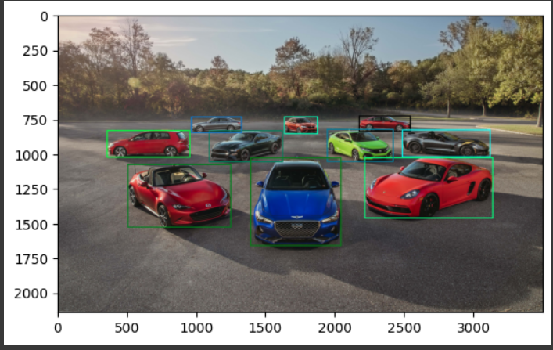
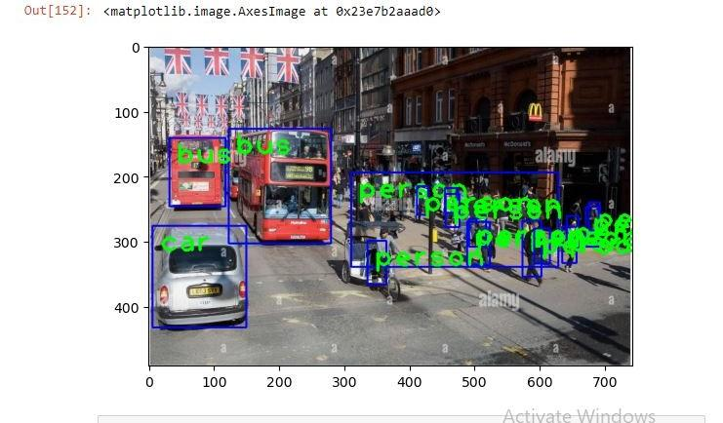
Results:

Slide 13
Conclusion:
In Conclusion, Object detection helping the visually impaired is a viable support system that allows for a more safe and secure lifestyle. This is a viable avenue to increase injury prevention and allow for more provisions in impasses of life. From our findings we can see that this avenue of taking pictures in strenuous situations for the visually impaired is not only feasible but also practical and ensures a new safeguard for them. Our models demonstrates that the results are well supported and can be implemented in various applications such as a smartwatch or mobile device or a pair of glasses

Slide 14
Thank You

